Slide 1
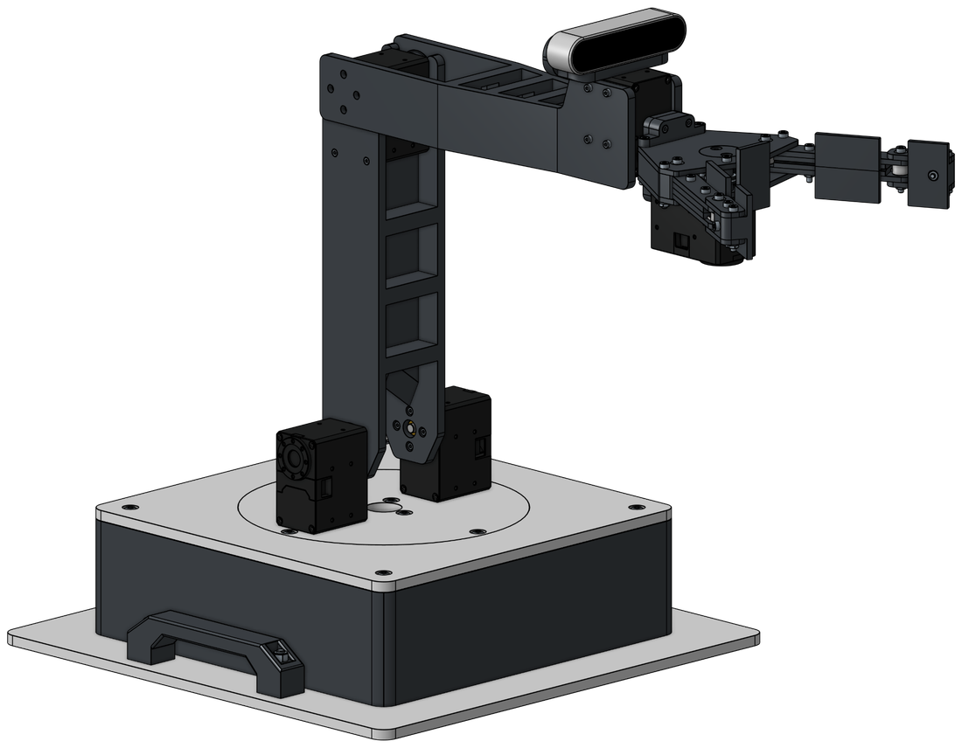
Code Implementation of Forward Kinematics and Other Methods
ROBOTIC ARM COURSE · LESSON 5 OF 12
Turning the DH recipe into working Python, then trying other methods
Day 1 · Forward kinematics in code
Day 2 · Other methods and the arm's reach

Slide 2
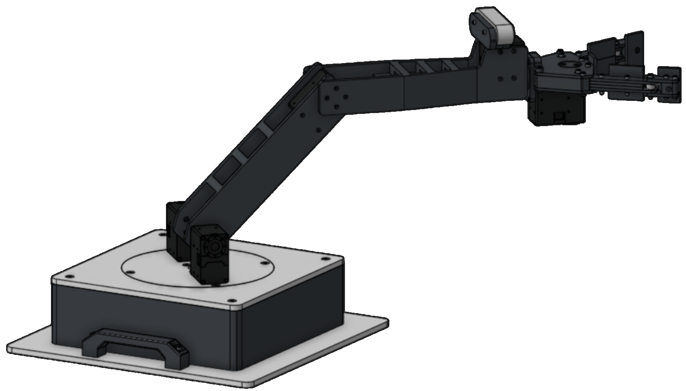
Where Lesson 4 Left Off
DAY 1 · OPENING
Joint
θ
d
a
α
LESSON 4'S ANSWER
(301.78, 301.78, 176.78) mm
1 · Base
θB
0
0
90°
for θB = θS = θE = 45°, from T = A₁ · A₂ · A₃ multiplied by hand
2 · Shoulder
90° − θS
0
250
0°
3 · Elbow
−θE
0
250
0°
TODAY
Let Python do the multiplying, and check it against this answer.
θ = 90° − θS for the shoulder and θ = −θE for the elbow, the same conversions as in Lesson 4.

Slide 3
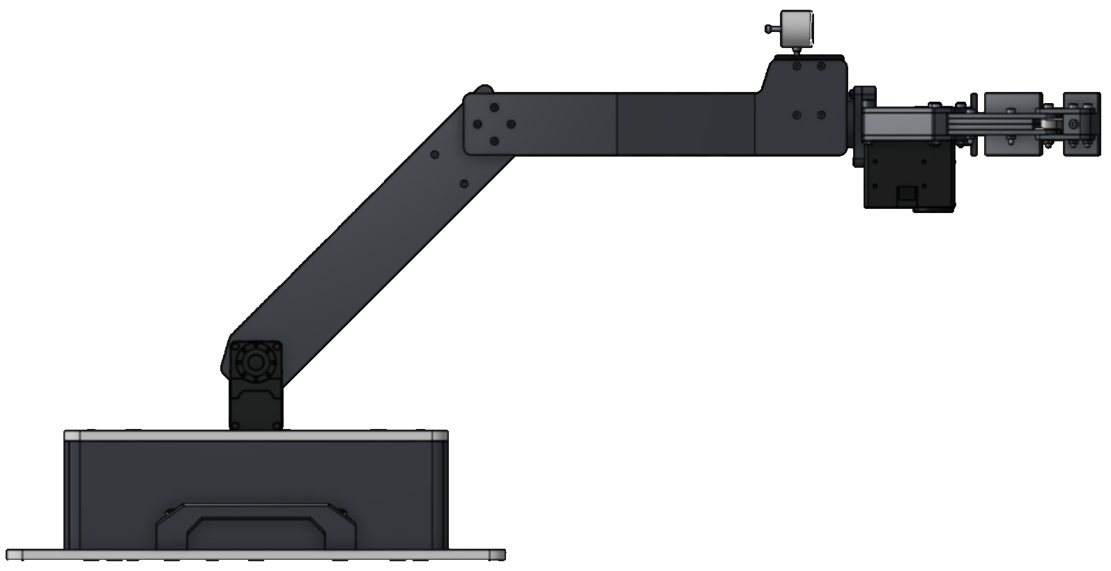
From Hand Steps to Code Steps
DAY 1 · OPENING
BY HAND (LESSON 4)
IN PYTHON (TODAY)
Read one row of the DH table, then build its matrix
→
A2 = dh_matrix(90 - theta_s, 0, L1, 0)
Multiply the three matrices in joint order
→
T = A1 @ A2 @ A3
Read the last column of T for the tip position
→
tip = T[:3, 3]
GOAL
One function that takes θB, θS and θE and gives back (x, y, z).

Slide 4
Setting Up Python
DAY 1 · SETUP
1
Check that Python 3 is installed
THE STARTER FILE HAS
python --version
Three things ready for you
It should print Python 3 and a version number. On some computers the command is python3.
L1 AND L2
2
Install NumPy
The link lengths, 250 mm each, written once at the top.
pip install numpy
NumPy does the matrix arithmetic. On some computers the command
is pip3.
show()
Prints a position rounded to 2 decimals.
3
Save the starter file as fk.py, then run it
python fk.py
TWO EMPTY FUNCTIONS
dh_matrix and forward_kinematics. You write them today.
It prints an error until the two functions are filled in. That is expected.

Slide 5
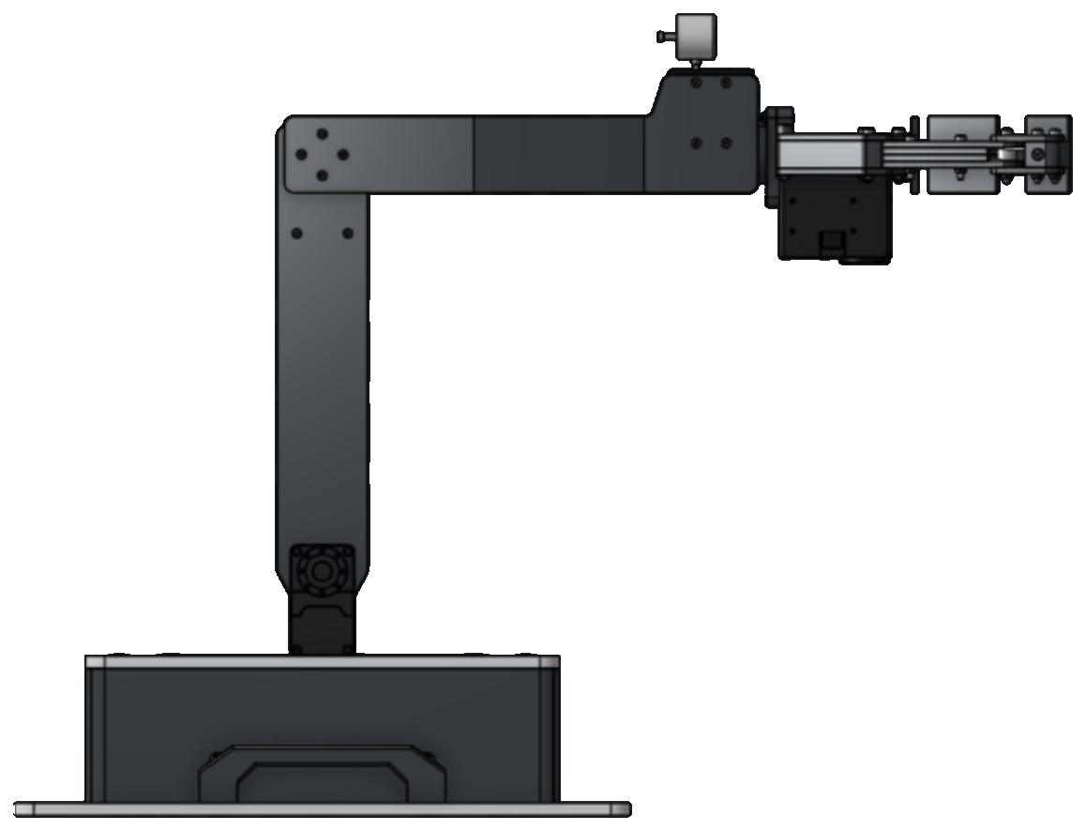
Four NumPy Tools
DAY 1 · SETUP
np.radians
np.sin, np.cos
np.radians(180)
np.sin(np.radians(90))
→ 3.141592653589793
→ 1.0
Turns degrees into radians. NumPy's sin and cos want radians.
Convert to radians first, then take the sine or cosine.
@
slicing
A = np.array([[1, 2], [3, 4]])
v = np.array([10, 20, 30, 40])
B = np.array([[0, 1], [1, 0]])
print(v[:3])
print(A @ B)
→ [10 20 30]
→ [[2 1]
[4 3]]
[:3] keeps the first three entries. T[:3, 3] keeps the first three rows
of column 3.
@ multiplies matrices. A * B would multiply entry by entry.

Slide 6
Try It Yourself #1
DAY 1 · TRY IT YOURSELF
Predict the output of each, then run it.
a
print(np.round(np.sin(np.radians(30)), 2))
b
print(np.round(250 * np.cos(np.radians(45)), 2))
c
M = np.array([[1, 2], [3, 4]])
v = np.array([1, 1])
print(M @ v)
SOLUTION
a → 0.5
NOTICE
b → 176.78
176.78 is ΔX1 from Lesson 3
It is also 250 · cos 45°, the first rotation example in Lesson 4.
c → [3 7]

Slide 7
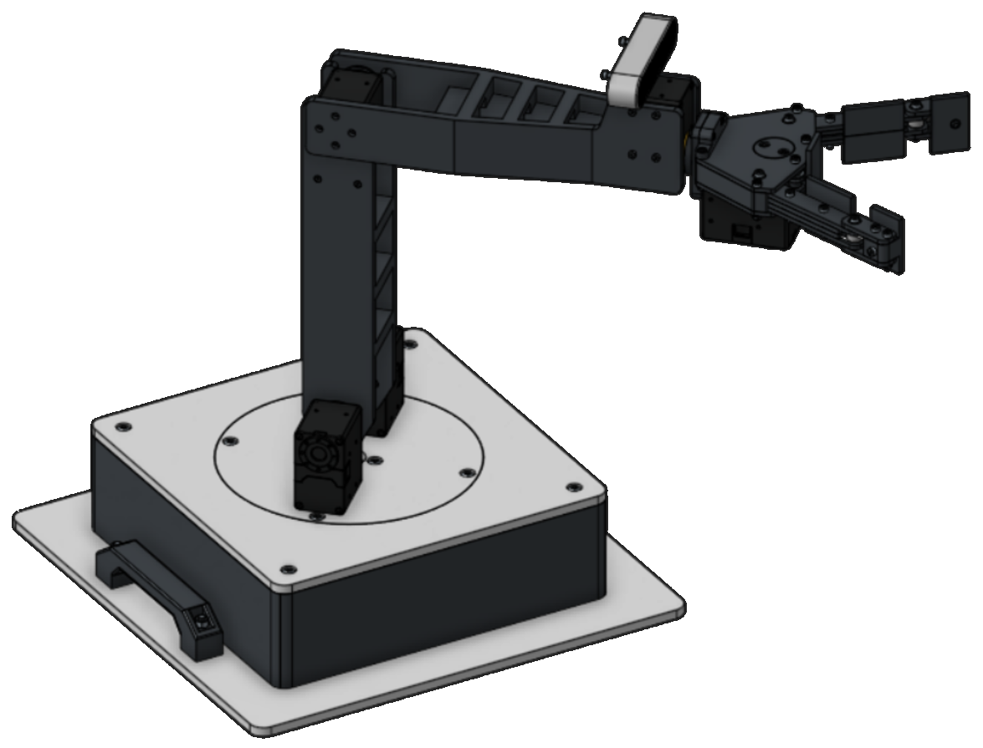
Step 1: A Function for One Joint
DAY 1 · STEP 1
THE FUNCTION WE WRITE FIRST
def dh_matrix(theta, d, a, alpha):
IN: FOUR NUMBERS
OUT: ONE 4×4 MATRIX
θ turn about z (degrees)
cos θ
−sin θ cos α
sin θ sin α
a cos θ
d slide along z (mm)
a slide along x (mm)
sin θ
cos θ cos α
−cos θ sin α
a sin θ
α turn about x (degrees)
0
sin α
cos α
d
0
0
0
1
The matrix from Lesson 4, slide 22.

Slide 8
Writing dh_matrix
DAY 1 · STEP 1
PYTHON
LINES 2–3
def dh_matrix(theta, d, a, alpha):
Degrees to radians first, because NumPy wants radians.
t = np.radians(theta)
al = np.radians(alpha)
ct, st = np.cos(t), np.sin(t)
LINES 4–5
ca, sa = np.cos(al), np.sin(al)
Short names: ct is cos θ, st is sin θ, ca is cos
α, sa is sin α.
return np.array([
[ct, -st * ca, st * sa, a * ct],
[st, ct * ca, -ct * sa, a * st],
[0, sa, ca, d],
LINES 6–11
One 4×4 array, row by row, from the matrix on the last slide.
[0, 0, 0, 1],
])

Slide 9
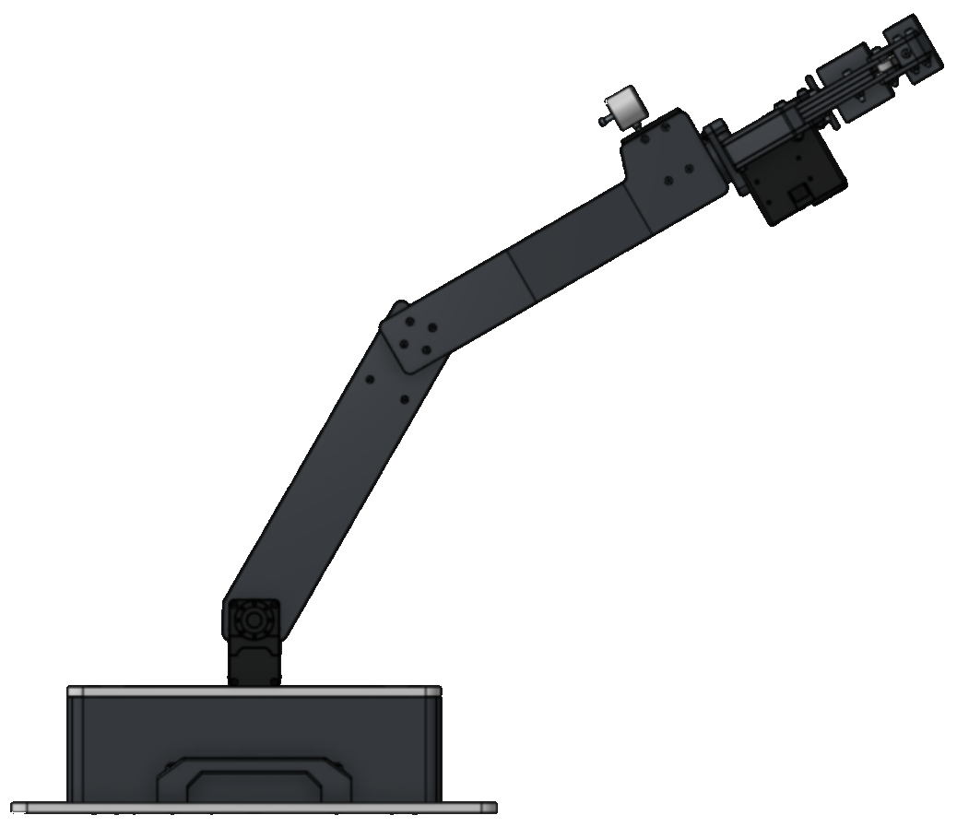
Test One Joint
DAY 1 · STEP 1
PYTHON
EXPECTED, FROM LESSON 4
show(dh_matrix(45, 0, 250, 0)[:3, 3])
A₂ (shoulder, θS = 45°): last column (176.78, 176.78, 0).
A₃ (elbow, θE = 45°): last column (176.78, −176.78, 0).
show(dh_matrix(-45, 0, 250, 0)[:3, 3])
OUTPUT
[176.78, 176.78, 0.0]
[176.78, -176.78, 0.0]
IF YOURS DIFFERS
Check np.radians on both angles, and the signs in the second row of the matrix.

Slide 10
Step 2: The DH Table in Code
DAY 1 · STEP 2
Joint
θ
d
a
α
Python
1 · Base
θB
0
0
90°
A1 = dh_matrix(theta_b, 0, 0, 90)
2 · Shoulder
90° − θS
0
250
0°
A2 = dh_matrix(90 - theta_s, 0, L1, 0)
3 · Elbow
−θE
0
250
0°
A3 = dh_matrix(-theta_e, 0, L2, 0)
ONE ROW, ONE CALL
L1 AND L2
Each row of the table becomes one dh_matrix call. The θ column keeps the conversions from Lesson 4.
The link lengths are set once at the top of the file. If the real arm is measured differently, change two numbers.

Slide 11
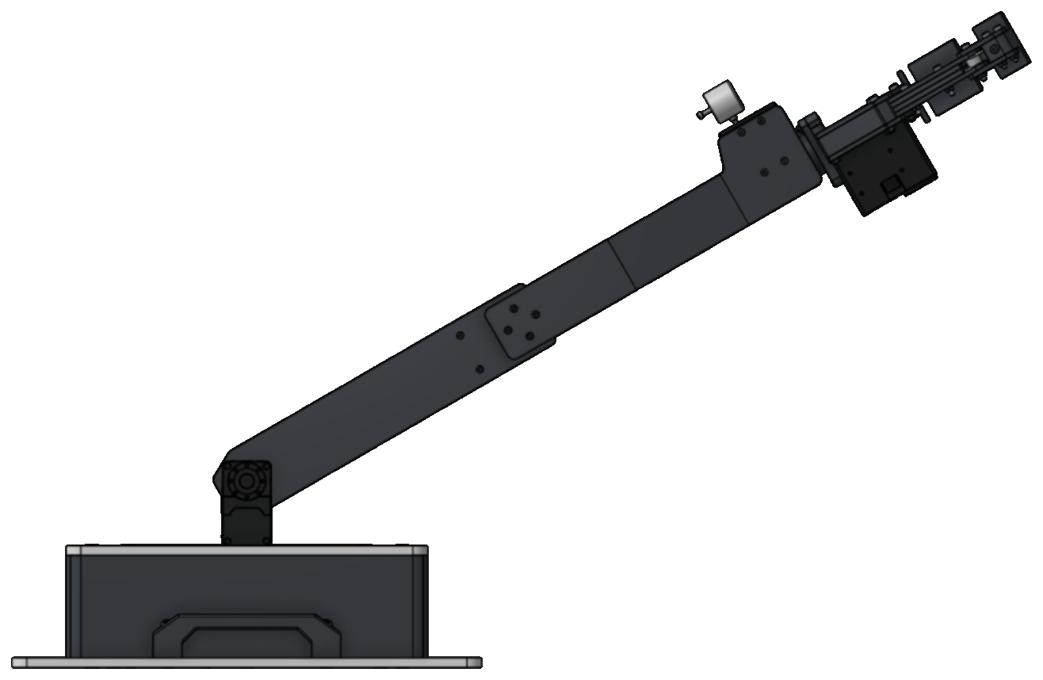
Step 3: Multiply and Read the Tip
DAY 1 · STEP 3
PYTHON
T, THE 4×4 RESULT
T = A1 @ A2 @ A3
·
·
·
x
return T[:3, 3]
·
·
·
y
JOINT ORDER
Base first, then shoulder, then elbow. A3 @ A2 @ A1 gives a different answer (Lesson 4, “Order Matters”).
·
·
·
z
0
0
0
1
T[:3, 3] is rows 0 to 2 of column 3, the x, y, z of the tip.

Slide 12
The Whole Function
DAY 1 · STEP 3
PYTHON
L1, L2
import numpy as np
The link lengths from Lesson 4.
L1 = 250 # upper arm (mm)
L2 = 250 # forearm (mm)
A1, A2, A3
def forward_kinematics(theta_b, theta_s, theta_e):
One row of the DH table each.
A1 = dh_matrix(theta_b, 0, 0, 90)
A2 = dh_matrix(90 - theta_s, 0, L1, 0)
T AND RETURN
A3 = dh_matrix(-theta_e, 0, L2, 0)
Multiply in joint order, then read the tip.
T = A1 @ A2 @ A3
return T[:3, 3]
WHERE IT GOES
Below dh_matrix, in the same file.

Slide 13
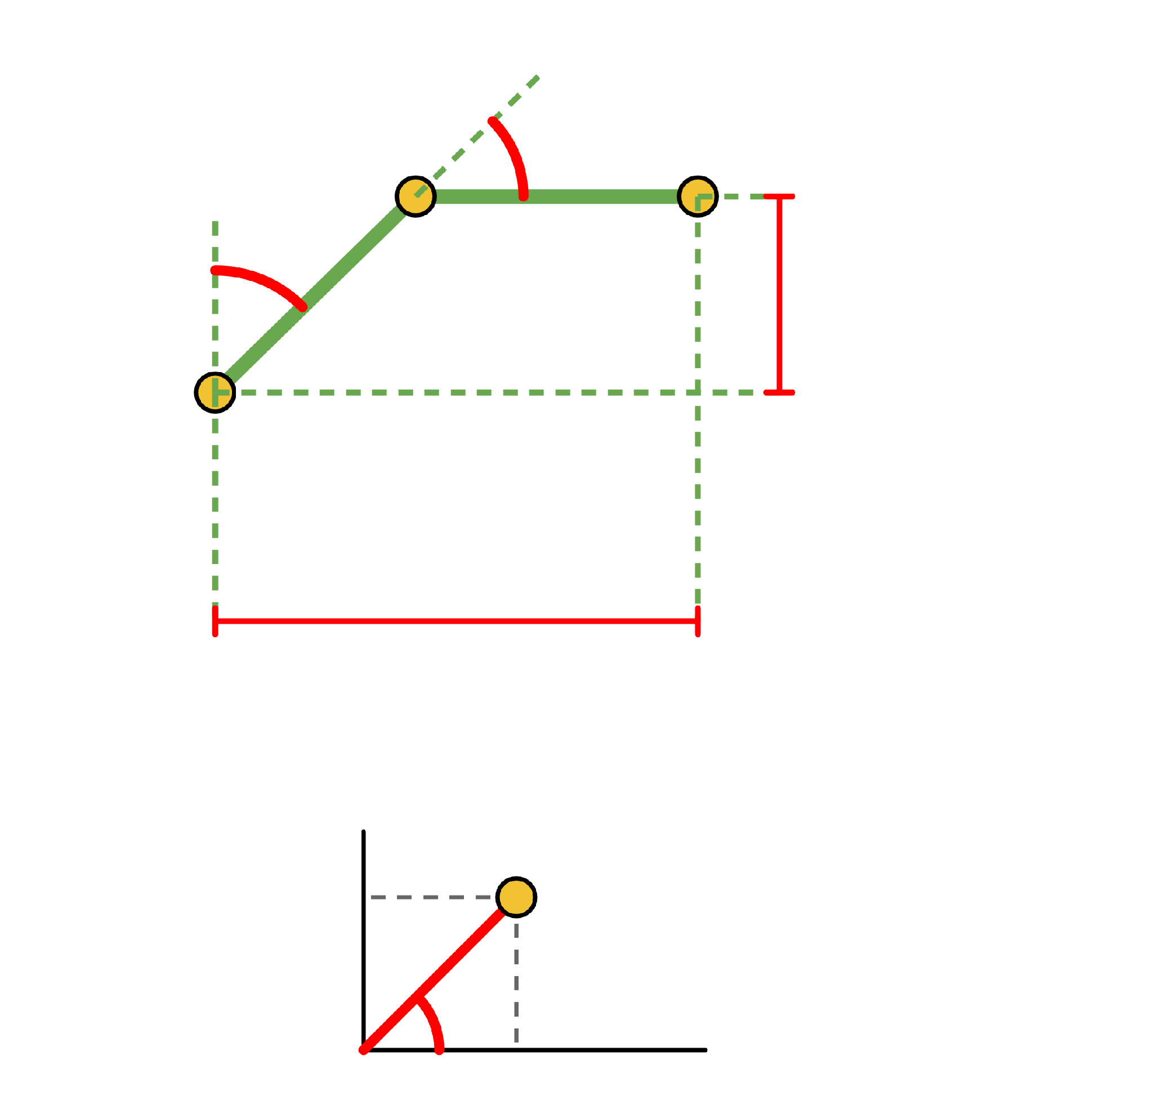
Run the Worked Example
DAY 1 · RUN IT
θE = 45°
PYTHON
tip = forward_kinematics(45, 45, 45)
show(tip)
θS = 45°
z = 176.78
OUTPUT
[301.78, 301.78, 176.78]
The same answer as Lesson 4.
r = 426.78
WHAT show() DOES
It only rounds the numbers to 2 decimals so the output is easy to read.
TOP VIEW
THE TIP (mm)
y
x = 301.78
y = 301.78
θB = 45°
x
z = 176.78

Slide 14
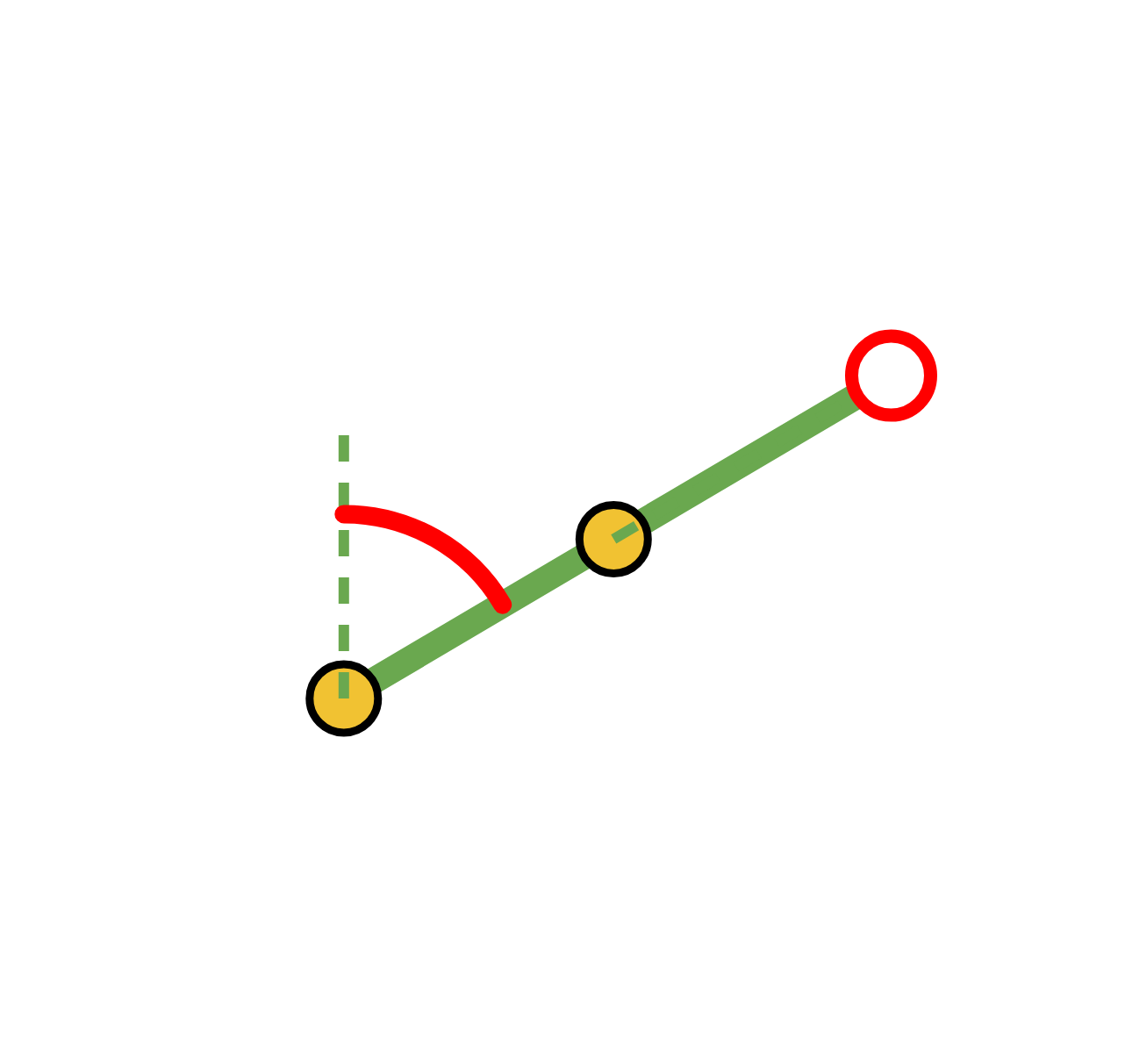
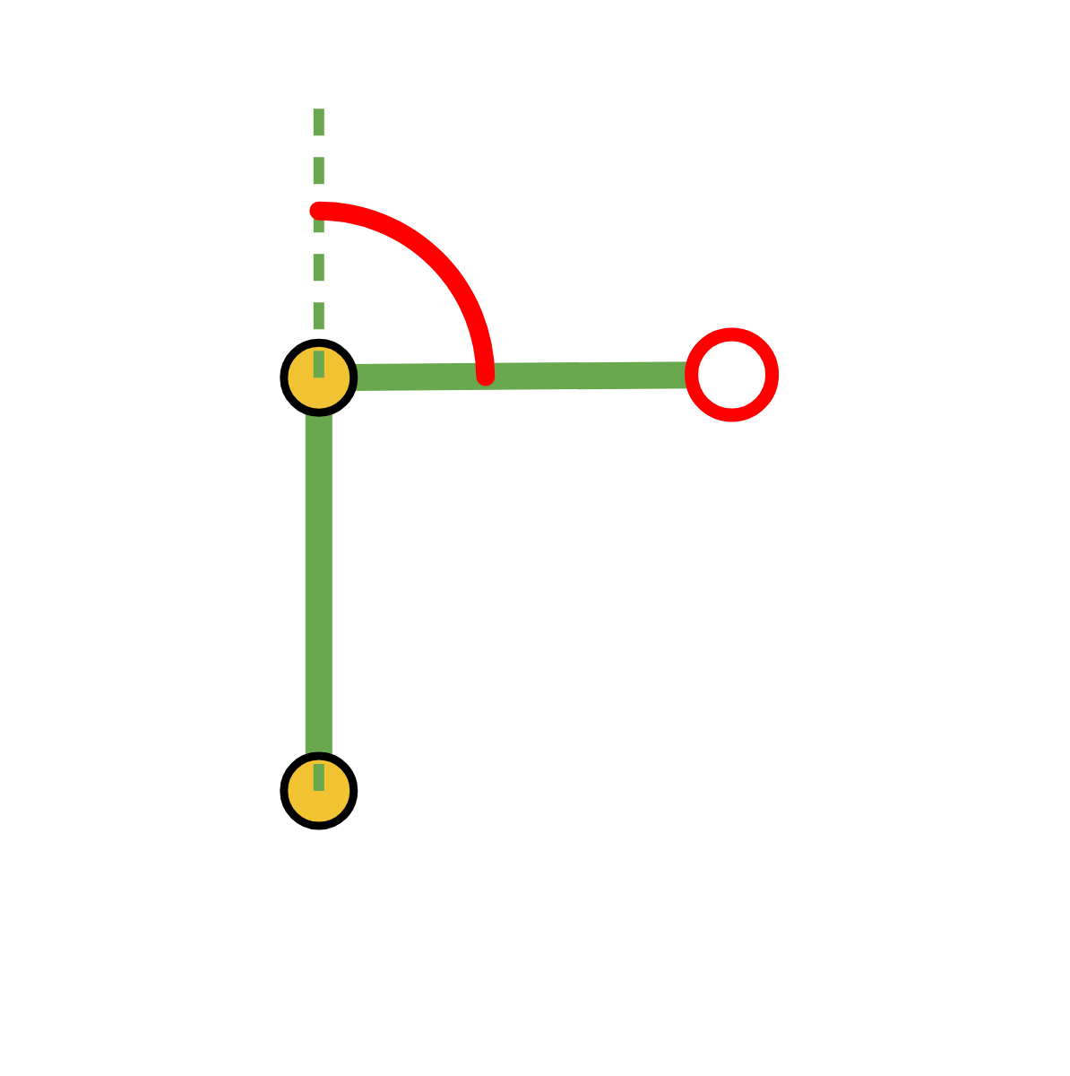
Try It Yourself #2
DAY 1 · TRY IT YOURSELF
Run Lesson 4's practice problems in code. Compare with your hand answers: they should match to 2 decimals.
#4
#5
LESSON 4, TRY IT YOURSELF #4
θE = 90°
θB = 30°, θS = 60°, θE = 0°
tip = ?
show(forward_kinematics(30, 60, 0))
θE = 0°
θS = 60°
tip = ?
θS = 0°
LESSON 4, TRY IT YOURSELF #5
θB = 120°, θS = 0°, θE = 90°
show(forward_kinematics(120, 0, 90))
#5 · SOLUTION
#4 · SOLUTION
[-125.0, 216.51, 250.0]
[375.0, 216.51, 250.0]
Same as Lesson 4. Python drops trailing zeros: 375.00 prints as 375.0.

Slide 15
Why Write a Test?
DAY 1 · TESTING
A test runs the function on poses where we already know the answer.
Angles (θB, θS, θE)
Expected tip (x, y, z) in mm
How we know
(0, 0, 0)
(0, 0, 500)
Arm straight up
(90, 0, 0)
(0, 0, 500)
Base turns; the tip stays on the axis
(0, 90, 0)
(500, 0, 0)
Straight out along x
(90, 90, 0)
(0, 500, 0)
Straight out along y
(45, 45, 45)
(301.78, 301.78, 176.78)
Worked example, Lessons 3 and 4
(30, 60, 0)
(375.00, 216.51, 250.00)
Lesson 4, Try It Yourself #4
(120, 0, 90)
(−125.00, 216.51, 250.00)
Lesson 4, Try It Yourself #5

Slide 16
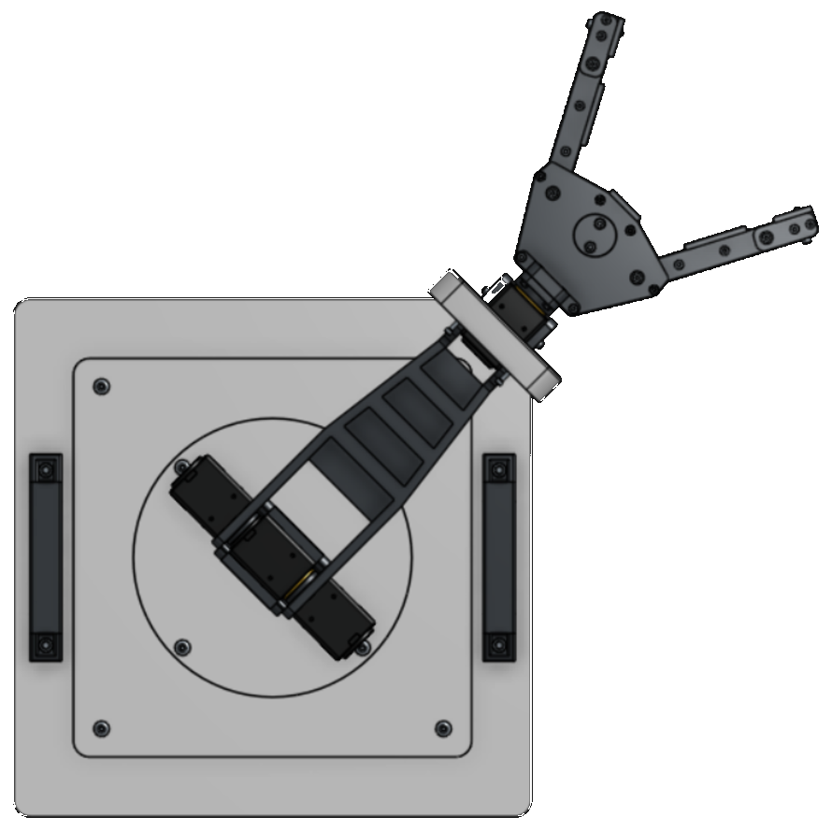
The Test File
DAY 1 · TESTING
check_fk.py
np.allclose
import numpy as np
Compares two lists number by number
and allows a small difference (atol =
0.01).
from fk import forward_kinematics as fk
TESTS = [
((0, 0, 0), (0, 0, 500)),
((45, 45, 45), (301.78, 301.78, 176.78)),
WHY NOT ==
# ... five more poses
Rounding: the exact answer 301.7767…
is not exactly 301.78.
]
for angles, expected in TESTS:
got = fk(*angles)
*angles
ok = np.allclose(got, expected, atol=0.01)
Unpacks (45, 45, 45) into three separate
arguments.
print("PASS" if ok else "FAIL", angles)

Slide 17
Run the Test
DAY 1 · TESTING
python check_fk.py
PASS (0, 0, 0) -> [0.0, 0.0, 500.0] expected [0.0, 0.0, 500.0]
PASS (90, 0, 0) -> [0.0, 0.0, 500.0] expected [0.0, 0.0, 500.0]
PASS (0, 90, 0) -> [500.0, 0.0, 0.0] expected [500.0, 0.0, 0.0]
PASS (90, 90, 0) -> [0.0, 500.0, 0.0] expected [0.0, 500.0, 0.0]
PASS (45, 45, 45) -> [301.78, 301.78, 176.78] expected [301.78, 301.78, 176.78]
PASS (30, 60, 0) -> [375.0, 216.51, 250.0] expected [375.0, 216.51, 250.0]
PASS (120, 0, 90) -> [-125.0, 216.51, 250.0] expected [-125.0, 216.51, 250.0]
7 of 7 tests passed
ALL PASS
A FAIL LINE
The function agrees with every hand answer and every pose we can check by eye.
Compare the two lists on that line, then try the bug hunt on the next slide.

Slide 18
Bug Hunt
DAY 1 · DEBUGGING
FOR 45°, 45°, 45° THE RIGHT ANSWER IS
[301.78, 301.78, 176.78]
Each broken version below gives one of the three wrong outputs. Match them.
A
t = theta
1
[426.78, -176.78, 0.0]
al = alpha
2
[125.0, 125.0, 426.78]
B
T = A3 @ A2 @ A1
C
3
[281.43, 274.4, 190.18]
A2 = dh_matrix(theta_s, 0, L1, 0)
A3 = dh_matrix(theta_e, 0, L2, 0)

Slide 19
Bug Hunt: Answers
DAY 1 · DEBUGGING
A → 3
B → 1
C → 2
Forgot np.radians
Wrong multiplication order
Forgot the θ conversions
sin and cos received degrees. Fix: t = np.radians(theta).
The joints must be multiplied base first. Fix: T = A1 @ A2 @ A3.
The θ column is 90 − theta_s and −theta_e.
THE STRAIGHT-UP TEST CATCHES ALL THREE
For (0, 0, 0) the right answer is [0.0, 0.0, 500.0]. The bugs give:
A: [-224.04, -200.29, 399.62]
B: [250.0, 250.0, 0.0]
C: [500.0, 0.0, 0.0]

Slide 20
Day 1 Recap
DAY 1 · WRAP-UP
1
2
3
dh_matrix
forward_kinematics
check_fk.py
One joint: one row of the DH table becomes one 4×4 matrix.
Three matrices, multiplied in joint order with @. The tip is T[:3, 3].
Seven poses with known answers:
7 of 7 tests passed.
NEXT TIME
The same tip, found in other ways.
Trigonometry, a new method called screw theory, and a map of where the tip can go.

Slide 21
Day 2: Where We Left Off
DAY 2 · OPENING
QUESTION 1
ANSWER 1
What does dh_matrix return?
A 4×4 matrix.
QUESTION 2
ANSWER 2
Why do we write @ and not * between matrices?
* multiplies entry by entry. @ multiplies matrices.
QUESTION 3
ANSWER 3
What should forward_kinematics(0, 0, 0) give, and
why?
[0.0, 0.0, 500.0]: the arm points straight up, 250 + 250 mm.

Slide 22
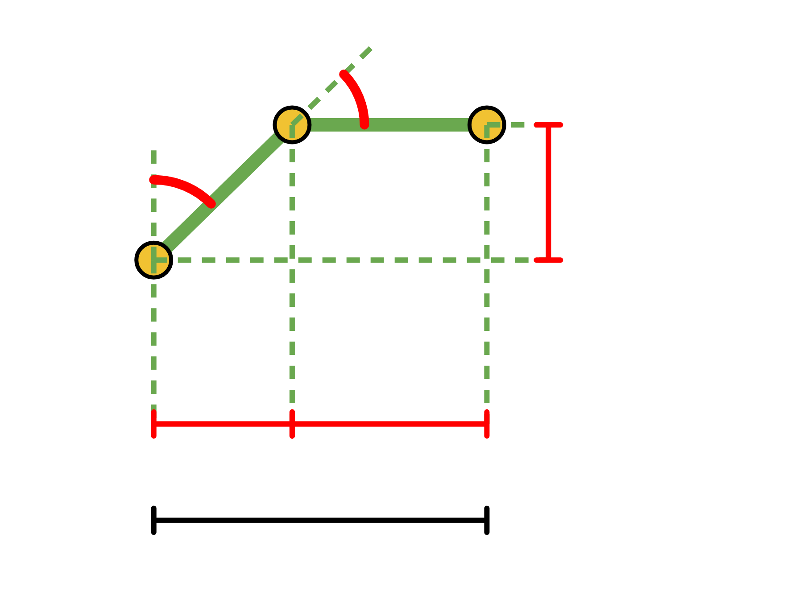
Lesson 3 in Code
DAY 2 · TRIGONOMETRY IN CODE
θE
compare_methods.py
def trig_fk(theta_b, theta_s, theta_e):
b = np.radians(theta_b)
θS
s = np.radians(theta_s)
z = 176.78
se = np.radians(theta_s + theta_e)
r = L1 * np.sin(s) + L2 * np.sin(se)
z = L1 * np.cos(s) + L2 * np.cos(se)
return np.array([r * np.cos(b), r * np.sin(b), z])
176.78
250
r = 426.78
WHERE IT GOES
A new file next to fk.py. Start it with import numpy as np and from fk import forward_kinematics as fk, L1, L2.
x AND y
Turn r by the base angle θB.
LESSON 3 USED Y FOR UP
Here z is up, as in Lesson 4.

Slide 23
Do the Methods Agree?
DAY 2 · TRIGONOMETRY IN CODE
compare_methods.py, BELOW trig_fk
OUTPUT
import random
True
worst = 0
for _ in range(2000):
angles = [random.uniform(-180, 180) for _ in range(3)]
WHAT IT MEANS
diff = np.abs(fk(*angles) - trig_fk(*angles)).max()
Over 2,000 random poses, the biggest
difference between the two functions is
smaller than 0.000001 mm.
worst = max(worst, diff)
print(worst < 0.000001)
TWO METHODS
Different maths, same arm, same answer.

Slide 24
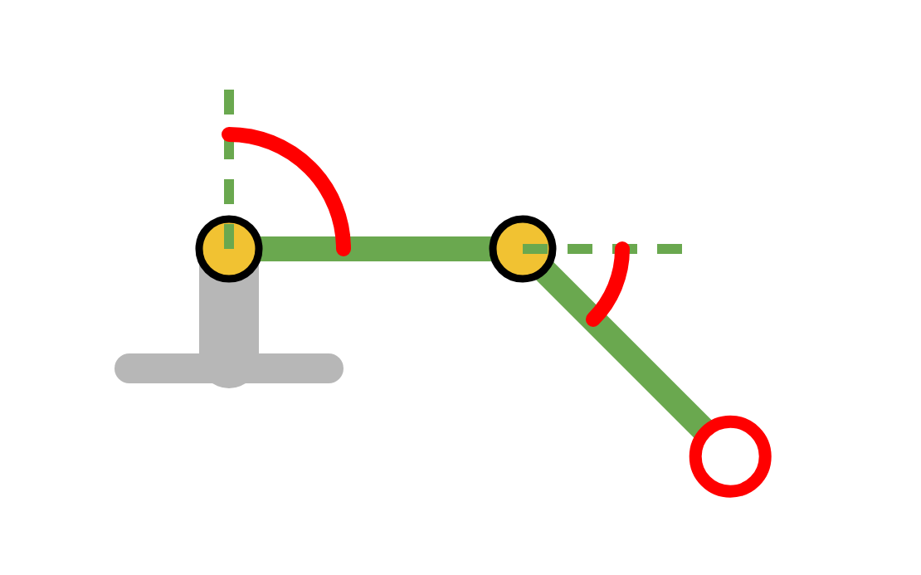
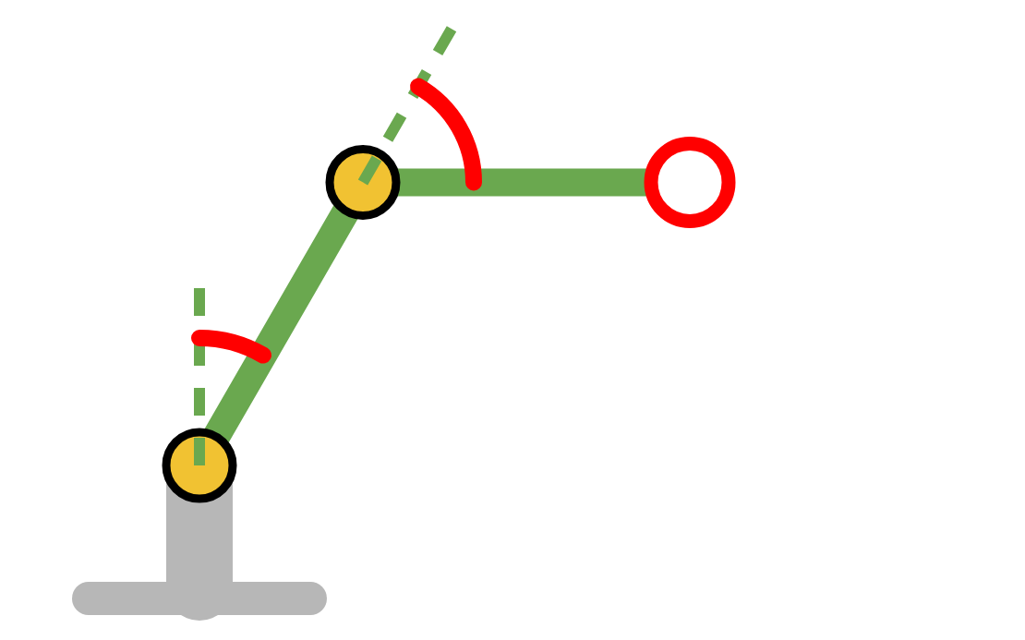
Try It Yourself #3
DAY 2 · TRY IT YOURSELF
Find r and z with a calculator, then check with code. The side view is drawn for each problem.
r = 250 · sin θS + 250 · sin(θS + θE) z = 250 · cos θS + 250 · cos(θS + θE)
x = r · cos θB y = r · sin θB
PROBLEM (a)
PROBLEM (b)
θE
θB = 90°
θS
θB = 0°
θS = 90°
θS = 30°
θS
θE = 45°
θE
θE = 60°
(x, y, z) = (?, ?, ?)
(x, y, z) = (?, ?, ?)
(a) SOLUTION
(b) SOLUTION
r = 426.78, z = −176.78
r = 375.00, z = 216.51
[0.0, 426.78, -176.78]
[375.0, 0.0, 216.51]
θS + θE = 135°, so the forearm points below horizontal and z is negative.
θS + θE = 90°, so the forearm is horizontal and adds 250 mm to r.

Slide 25
A Second Way to Describe the Arm
DAY 2 · SCREW THEORY
LESSON 4
TODAY
DH matrices
Screw theory
A coordinate frame on every joint.
The arm in its zero pose.
A table of θ, d, a and α.
Each joint described by its turning axis: which way it points, and one point it passes through.
One matrix per row, multiplied from base to tip.
One matrix per turn, applied to the zero pose.
ALSO CALLED THE PRODUCT OF EXPONENTIALS
Both methods give the same tip position.
Screw theory needs no frames and no table, only the zero pose and one axis for each joint.

Slide 26
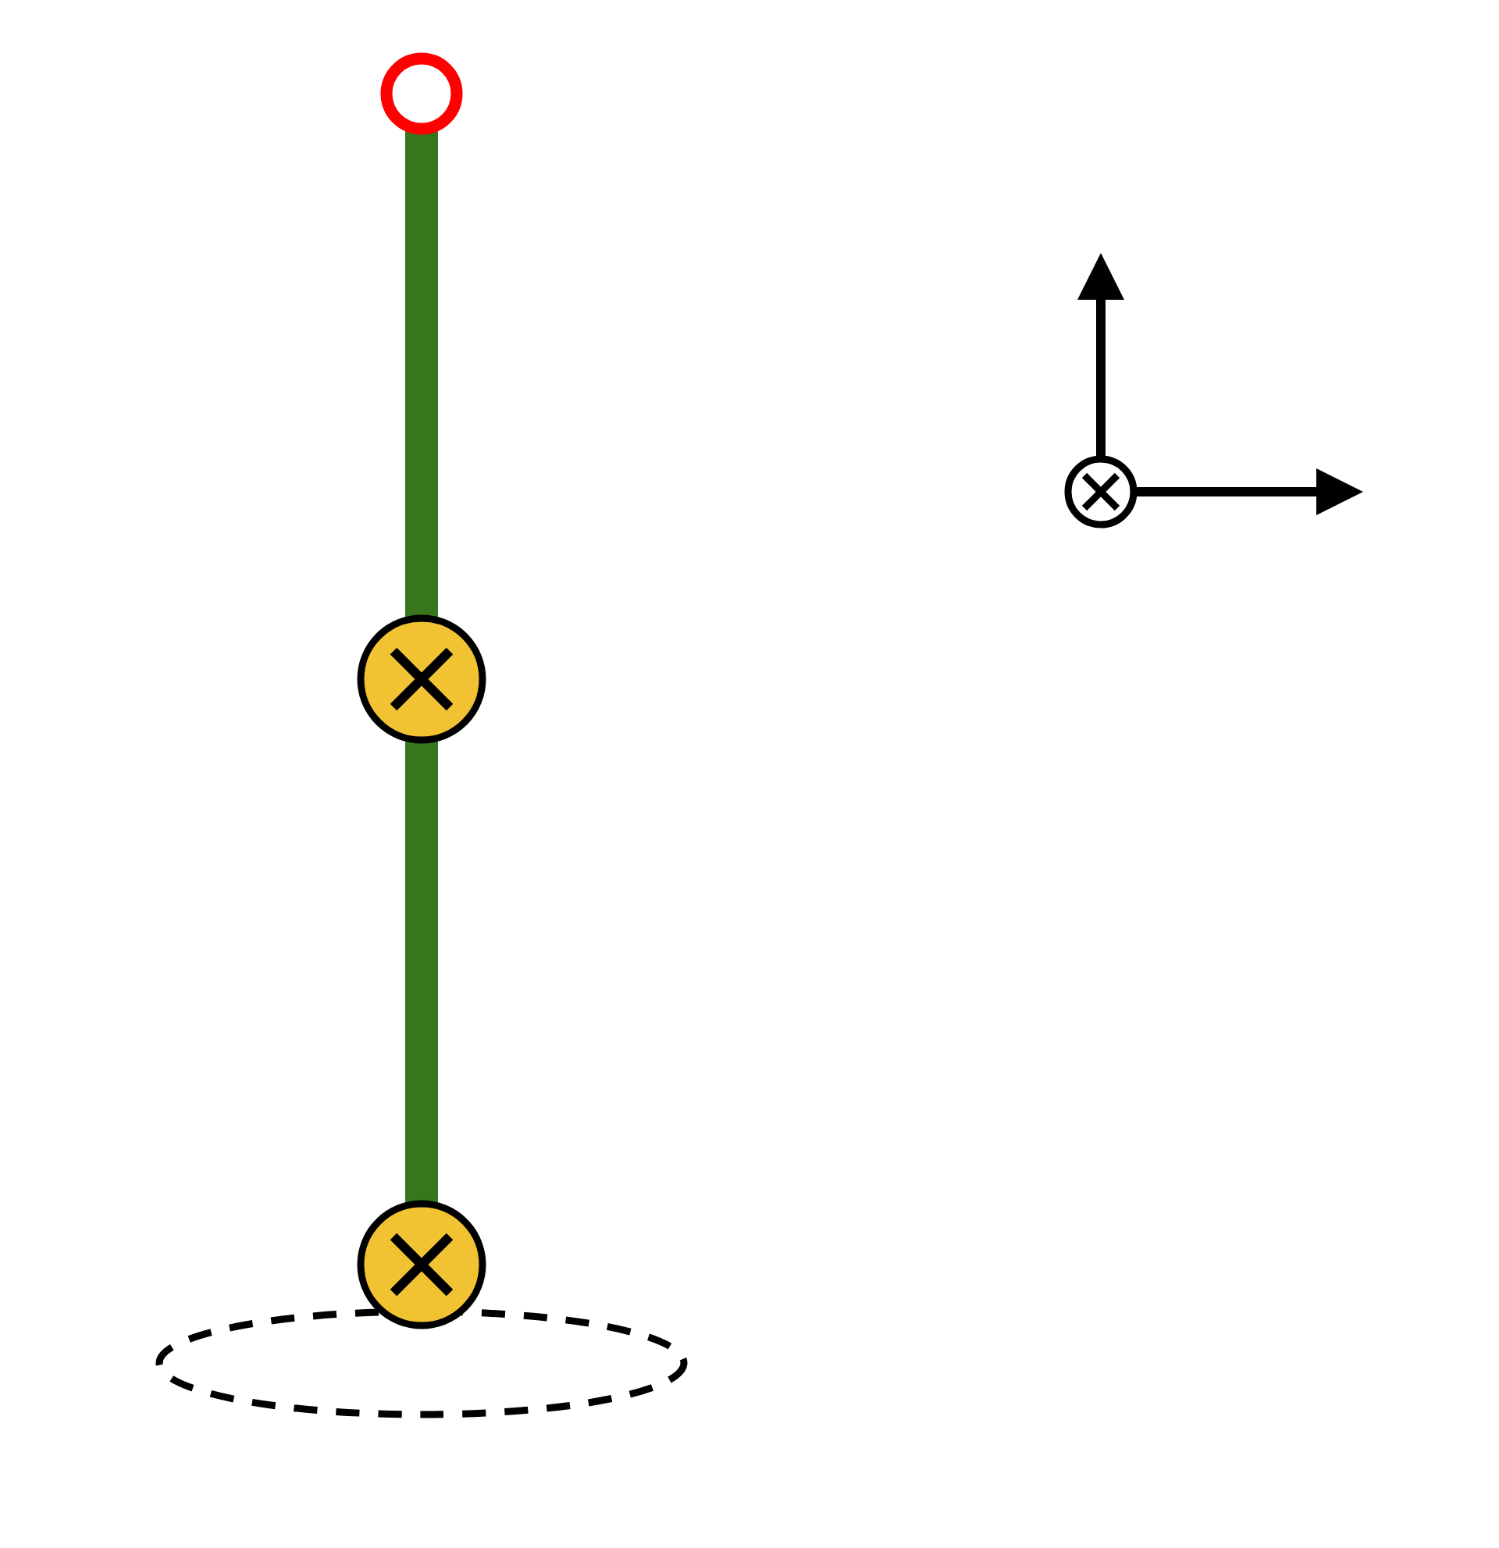
The Zero Pose and the Axes
DAY 2 · SCREW THEORY
Tip M = (0, 0, 500)
Joint
Axis points along
Passes through
z
Base
(0, 0, 1)
(0, 0, 0)
Shoulder
(0, 1, 0)
(0, 0, 0)
x
y: into the page
Elbow
(0, 1, 0)
(0, 0, 250)
Elbow axis along y,
through (0, 0, 250)
THE ZERO POSE
Every angle is 0 and the arm points straight up. x is forward, y is
sideways (into the page) and z is up.
Shoulder axis along y,
through (0, 0, 0)
THE PICTURE, TOP RIGHT
Base axis along z,
through (0, 0, 0)
There the shoulder is at 0° and the elbow is bent 90°. Straighten the
elbow and the forearm points up: the zero pose.

Slide 27
The Screw Recipe
DAY 2 · SCREW THEORY
THE TIP IS
T = (base turn) · (shoulder turn) · (elbow turn) · M
M is the matrix of the zero pose. The turn written next to M acts first.
1
2
3
The elbow turns first
Then the shoulder
Then the base
About its axis S3, by θE.
About its axis S2, by θS.
About its axis S1, by θB.
screw_matrix(S3, theta_e)
screw_matrix(S2, theta_s)
screw_matrix(S1, theta_b)
OPPOSITE ORDER TO DH, SAME ANSWER
DH reads from the base to the tip. Screw theory turns the elbow first, then the shoulder, then the base.

Slide 28
Screw Theory in Code
DAY 2 · SCREW THEORY
PYTHON
M
from screw_helper import screw_axis, screw_matrix
The tip at the zero pose: (0, 0, L1 + L2) = (0,
0, 500).
M = np.array([[1, 0, 0, 0],
[0, 1, 0, 0],
[0, 0, 1, L1 + L2],
screw_axis(direction, point)
[0, 0, 0, 1]])
The way the axis points, and one point it passes through.
S1 = screw_axis([0, 0, 1], [0, 0, 0])
S2 = screw_axis([0, 1, 0], [0, 0, 0])
S3 = screw_axis([0, 1, 0], [0, 0, L1])
screw_matrix(S, angle)
Turns a joint about its axis. It is in screw_helper.py, so you do not write it.

Slide 29
Worked Example: One Turn at a Time
DAY 2 · SCREW THEORY
θB = θS = θE = 45°. Follow the point p, starting at the zero-pose tip.
0
START
1
ELBOW
2
SHOULDER
3
BASE
p = [0, 0, 500, 1]
screw_matrix(S3, 45)
screw_matrix(S2, 45)
screw_matrix(S1, 45)
The zero-pose tip, with the extra 1.
Turn p about S3 by 45°.
Turn p about S2 by 45°.
Turn p about S1 by 45°.
(176.78, 0, 426.78)
(426.78, 0, 176.78)
(301.78, 301.78, 176.78)
(0, 0, 500)
THE SAME ANSWER
(301.78, 301.78, 176.78) mm
The same tip as Lessons 3 and 4, found by a third method.

Slide 30
Try It Yourself #4
DAY 2 · TRY IT YOURSELF
1 · Save fk_screw_starter.py as fk_screw.py.
fk_screw.py
def forward_kinematics_screw(theta_b, theta_s, theta_e):
2 · Replace the dots with one expression.
T = ... # turn, turn, turn, then M
3 · Change the import line in check_fk.py.
return T[:3, 3]
4 · Run check_fk.py.
IN check_fk.py, CHANGE THE IMPORT LINE TO
from fk_screw import forward_kinematics_screw as fk
SOLUTION
T = (screw_matrix(S1, theta_b)
RESULT
@ screw_matrix(S2, theta_s)
7 of 7 tests passed
@ screw_matrix(S3, theta_e)
Screw theory passes the same test as DH.
@ M)

Slide 31
Three Methods Compared
DAY 2 · COMPARING METHODS
Trigonometry
DH matrices
Screw theory
You describe
Right triangles for this arm
A frame on every joint, then a table
The zero pose and one axis per joint
In code
A few formulas
One matrix per table row
One matrix per axis, plus M
A new joint
New triangles
One more row
One more axis
45°, 45°, 45°
(301.78, 301.78, 176.78)
(301.78, 301.78, 176.78)
(301.78, 301.78, 176.78)
DISCUSS
If the arm had six joints, which method would you choose, and why?

Slide 32
Where Can the Tip Go?
DAY 2 · REACH
One function, called thousands of times, maps the arm's reach.
OUR PRACTICE RANGES
θB = 0° (a side view)
θS = 0° to 90°
θE = 0° to 90°
Steps of 5°
1
Loop over many shoulder and elbow angles.
2
Call forward_kinematics for each pair.
3
Collect the tip positions.
HOW MANY POSES
4
Plot them and measure the farthest and nearest points.
19 × 19 = 361
NOT THE REAL LIMITS
These ranges are for practice. They are not measured on the real arm.

Slide 33
Sweeping the Joint Angles
DAY 2 · REACH
workspace_sweep.py
OUTPUT
points = []
361 poses
for theta_s in range(0, 91, 5):
farthest: 500.0 mm
for theta_e in range(0, 91, 5):
nearest: 353.55 mm
x, y, z = fk(0, theta_s, theta_e)
points.append((x, z))
reach
points = np.array(points)
The distance from the shoulder to the tip: √(x² + z²).
reach = np.hypot(points[:, 0], points[:, 1])
print(len(points), "poses")
print("farthest:", round(reach.max(), 2), "mm")
THE PLOT
print("nearest:", round(reach.min(), 2), "mm")
workspace_sweep.py also draws the dots with matplotlib.

Slide 34
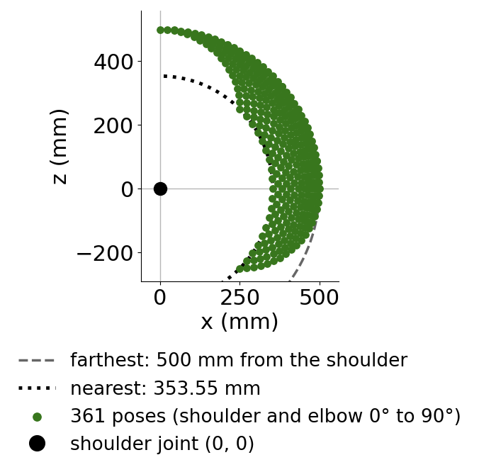
The Reachable Region
DAY 2 · REACH
FARTHEST: 500 mm
With the elbow straight (θE = 0°), the tip is 250 + 250 mm from the shoulder.
NEAREST: 353.55 mm
With the elbow bent 90°, the tip is 2 × 250 × cos 45° from the shoulder.
SPIN THE BASE
Turning θB from 0° to 360° sweeps this picture around the vertical z axis.

Slide 35
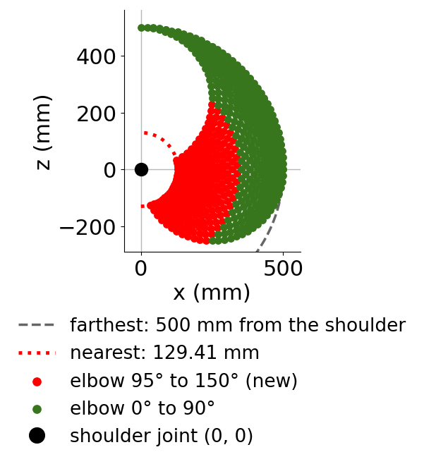
Try It Yourself #5
DAY 2 · TRY IT YOURSELF
Let the elbow bend up to 150°. Predict the new nearest distance, then run it.
for theta_e in range(0, 151, 5):
HINT
With the elbow bent by θE, the tip is 2 × 250 × cos(θE ÷ 2) from the shoulder.
SOLUTION
589 poses
farthest: 500.0 mm
nearest: 129.41 mm

Slide 36
Optional: From Motor Ticks to Angles
DAY 2 · OPTIONAL
PYTHON
4096 TICKS PER TURN
TICKS_PER_DEGREE = 4096 / 360
So 1° is 4096 ÷ 360 ≈ 11.38 ticks.
ZERO_TICKS = 2048 # [measure on the real arm]
def ticks_to_degrees(ticks, gear_ratio=1.0):
45° IS 512 TICKS
degrees = ticks - ZERO_TICKS
On the shoulder or elbow. The base motor is geared 3 to 1, so 45° of base is 1536 ticks.
return degrees / (TICKS_PER_DEGREE * gear_ratio)
MEASURE ZERO_TICKS
Read the ticks with the arm in its zero pose. 2048 is only the servo centre value used in waypoint.py. The motor direction may also need a sign flip.

Slide 37
What We Learned
WRAP-UP
1
A tested function
2
Three methods, one answer
forward_kinematics turns three joint angles into the tip position, and check_fk.py proves it.
Trigonometry, DH and screw theory all give (301.78, 301.78, 176.78) for 45°, 45°, 45°.
3
Good tests
4
The reach
Poses we can check by eye, like the straight-up arm, catch bugs fast.
Calling the function thousands of times maps where
the tip can go.
NEXT: LESSON 6
Trigonometric Approach to Inverse Kinematics
Going the other way: from a target position back to the joint angles.

